Slide 1

Tutorial Questions （Week 10）
Haohao Li (李好好)
Southern University of Science and Technology
Email: 12432581@mail.sustech.edu.cn

Slide 2
Review
Tutorial Problems with Answers
7.41 7.44 7.47 7.49
Q&A

Slide 3
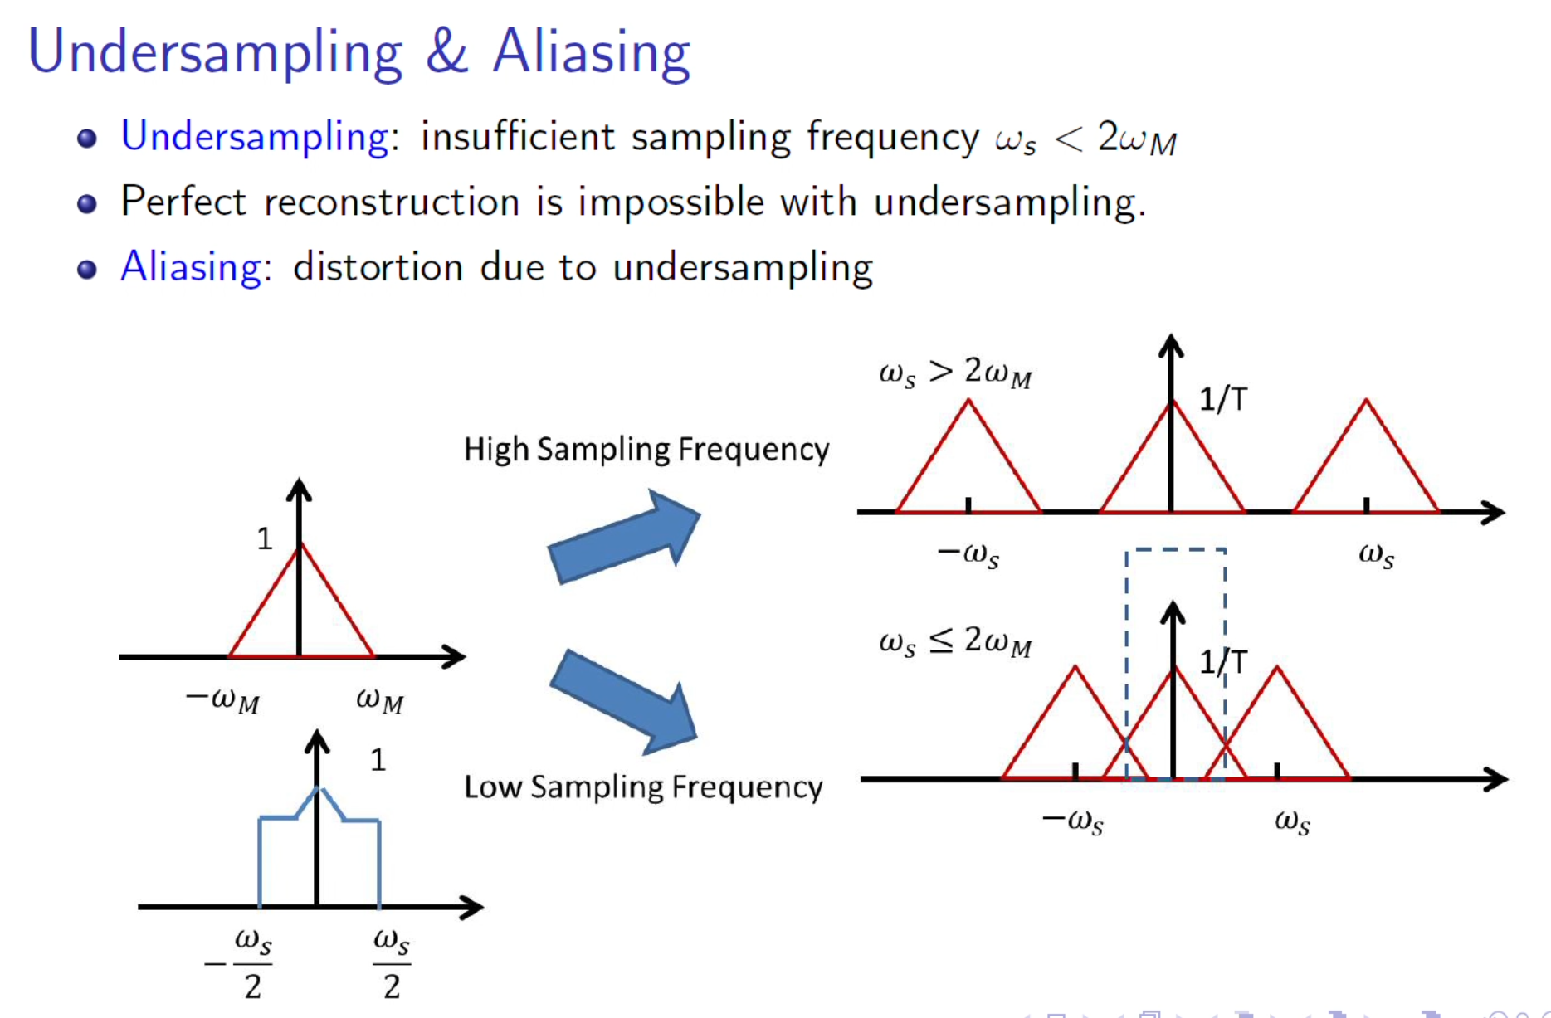

Slide 4
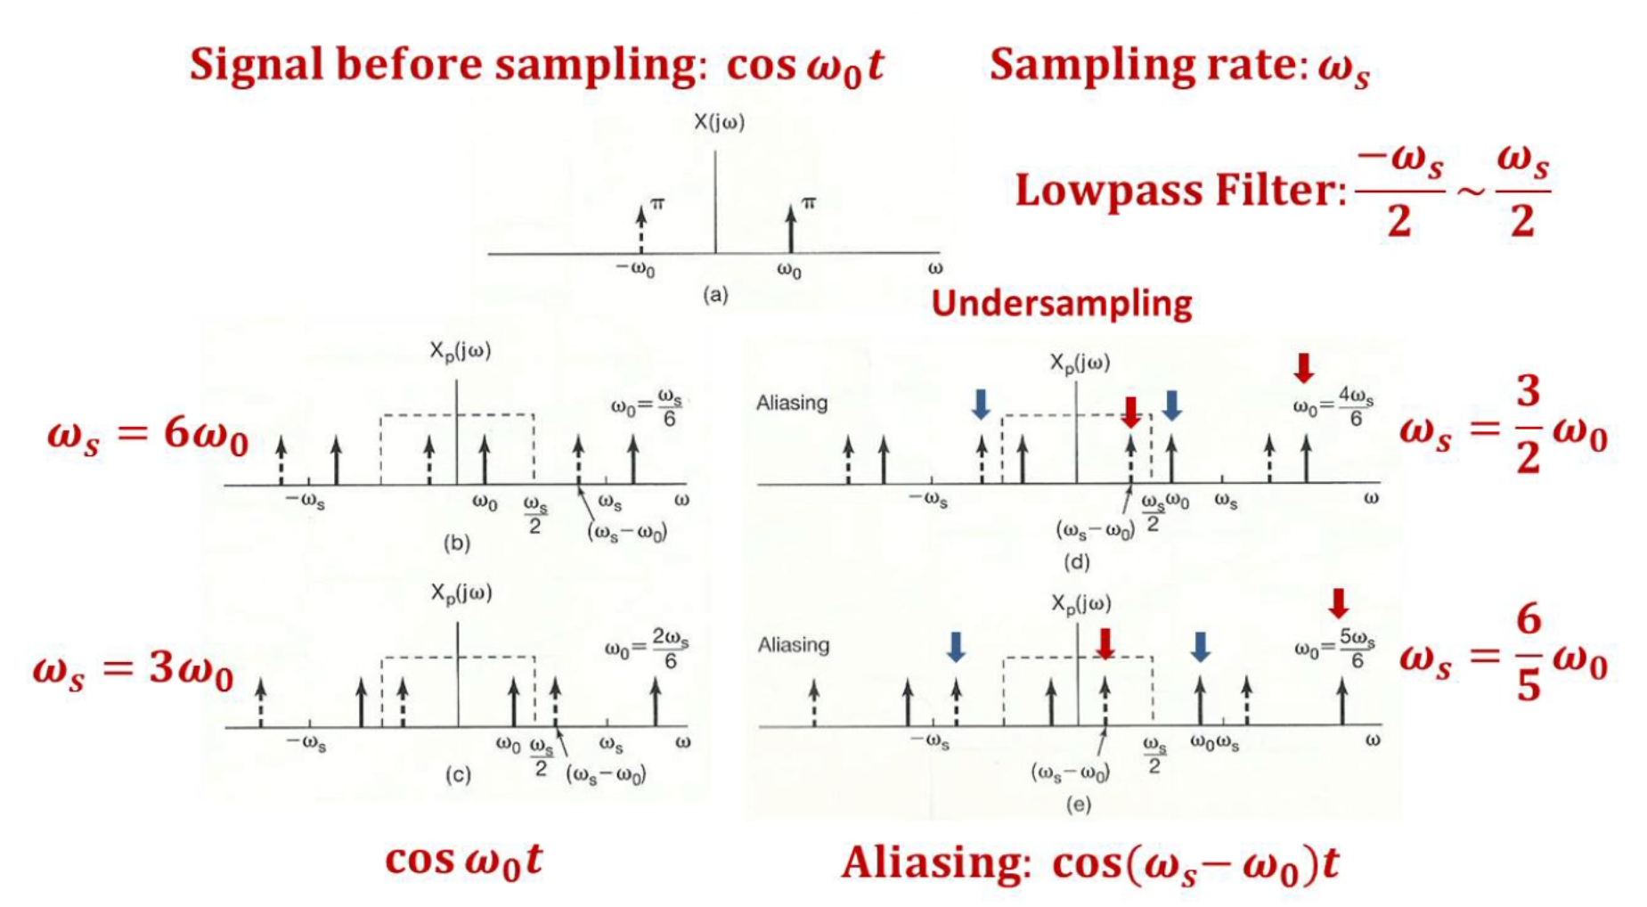

Slide 5
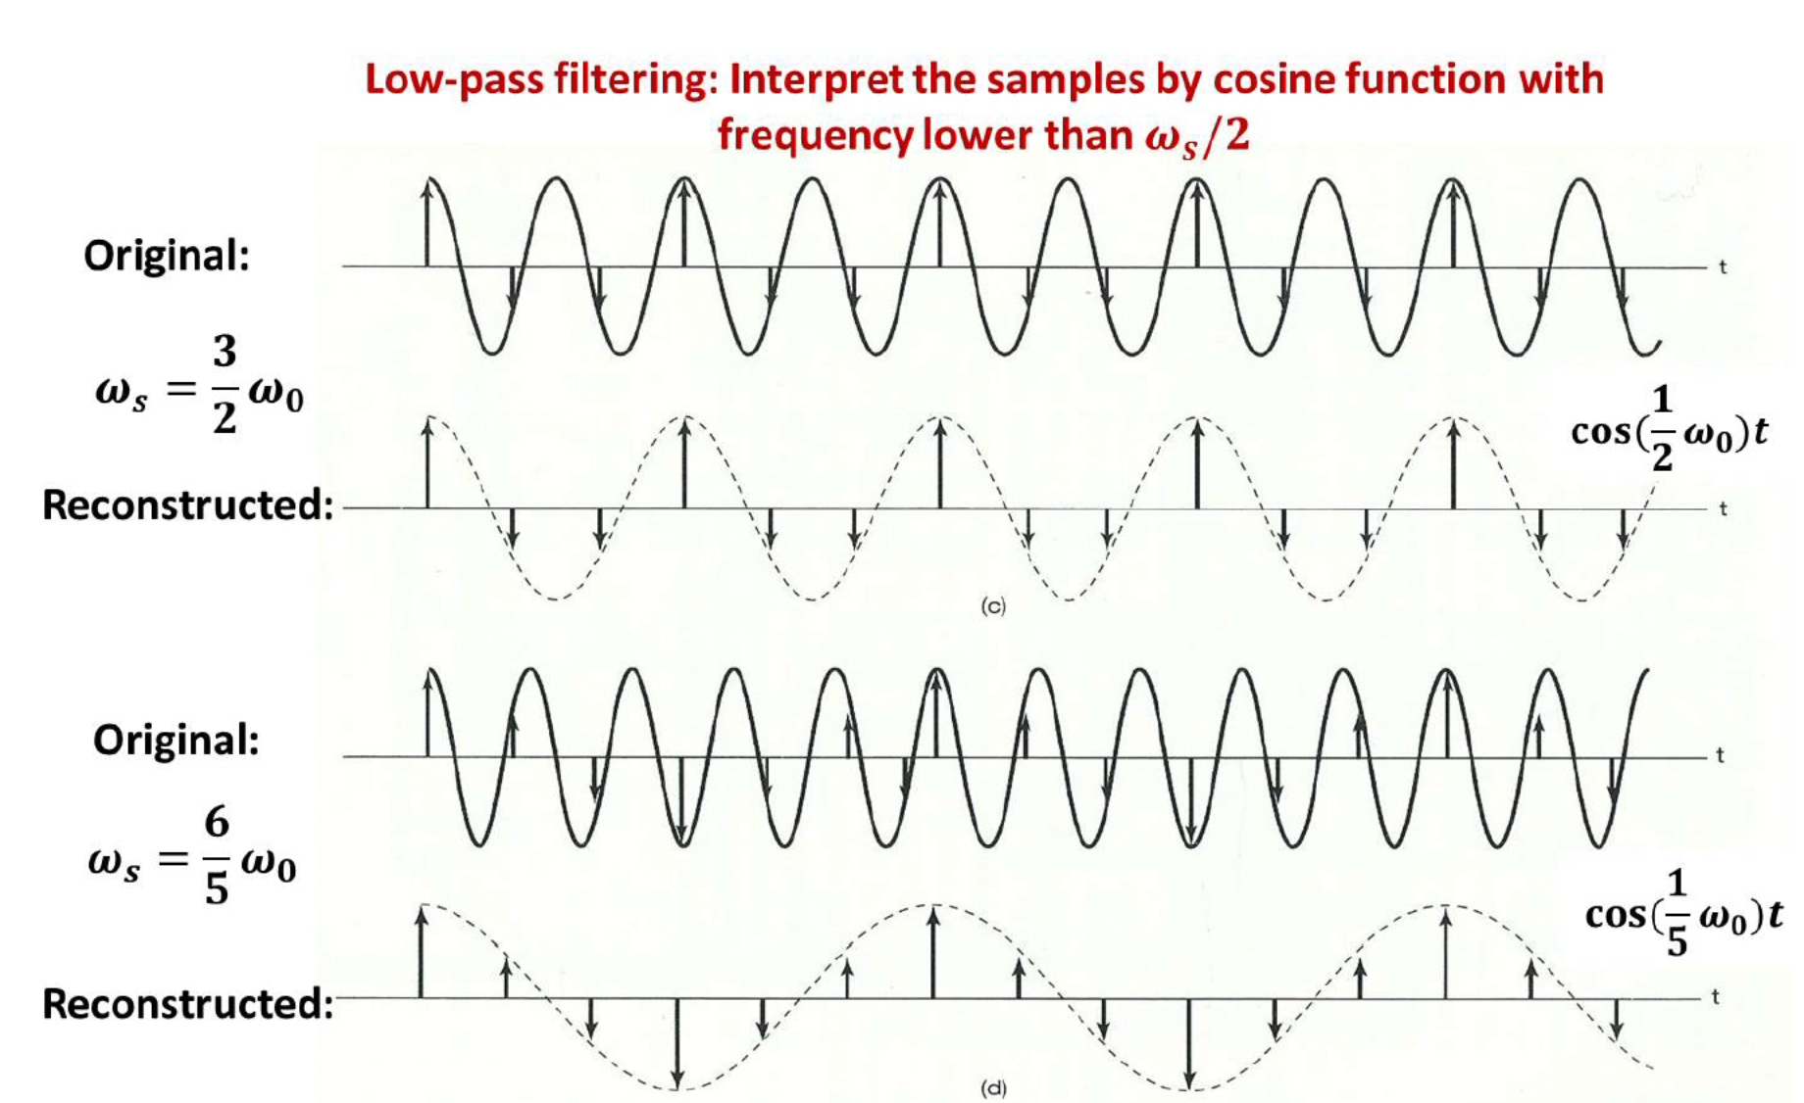

Slide 6
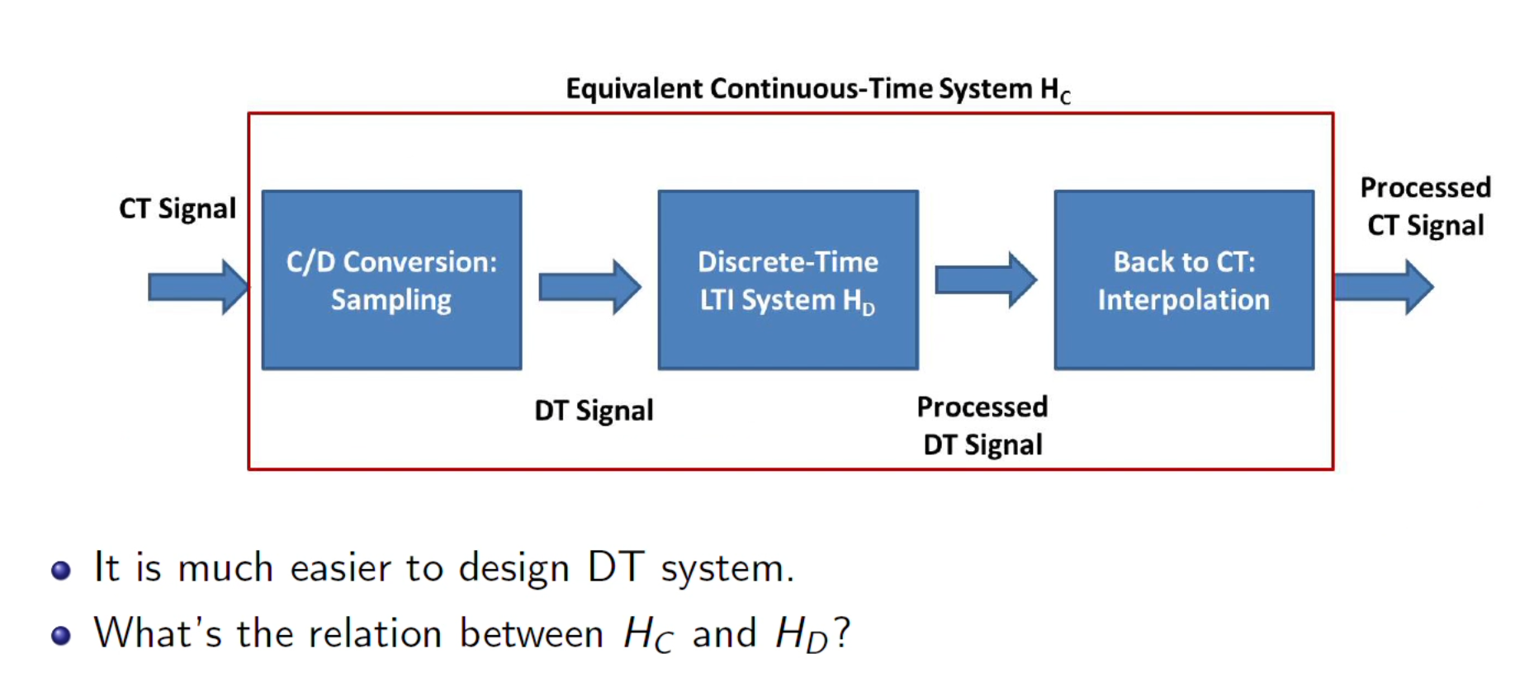

Slide 7
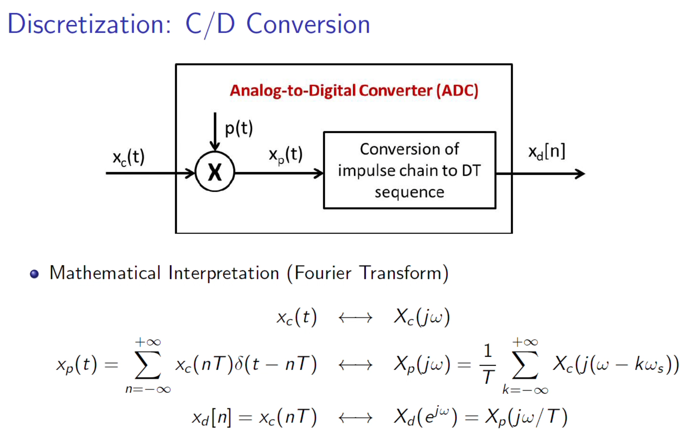

Slide 8
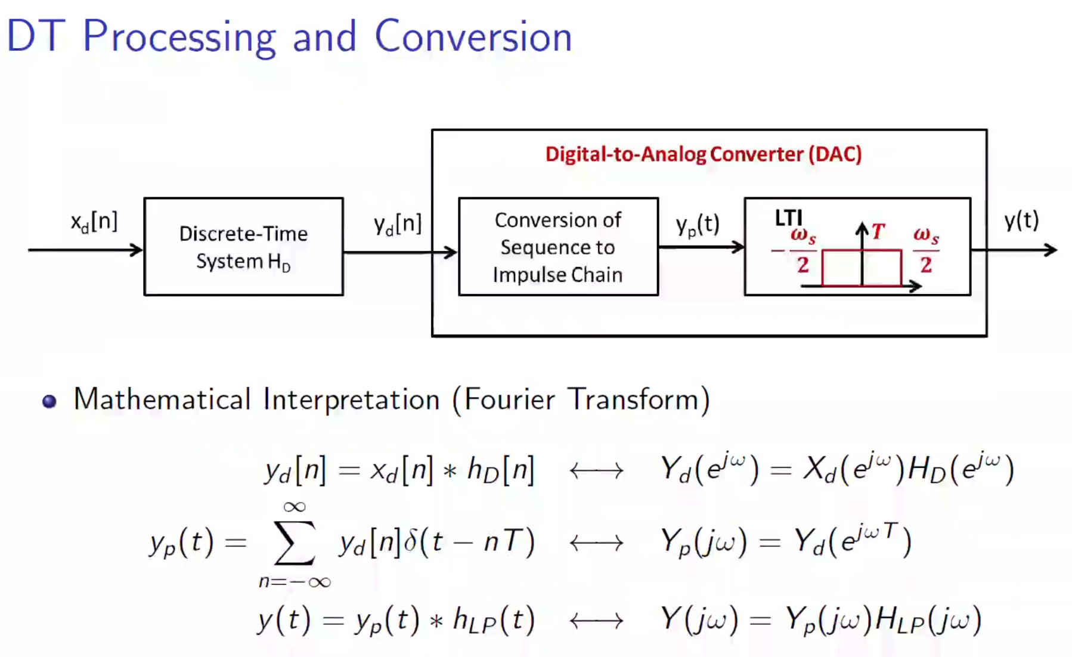

Slide 9
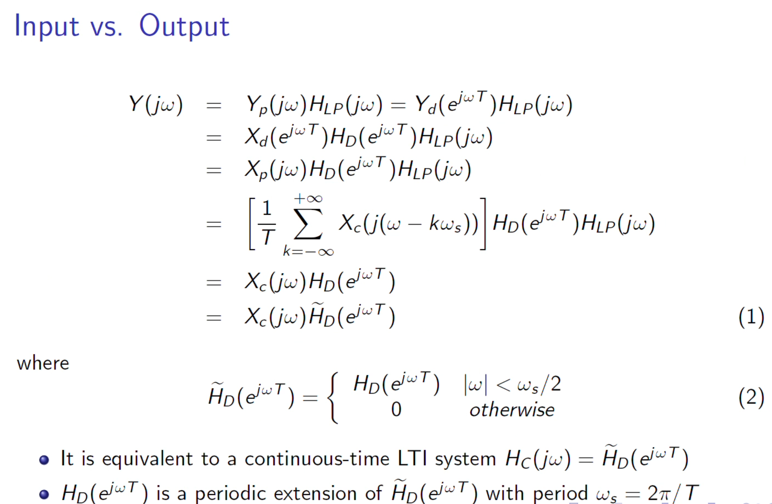

Slide 10
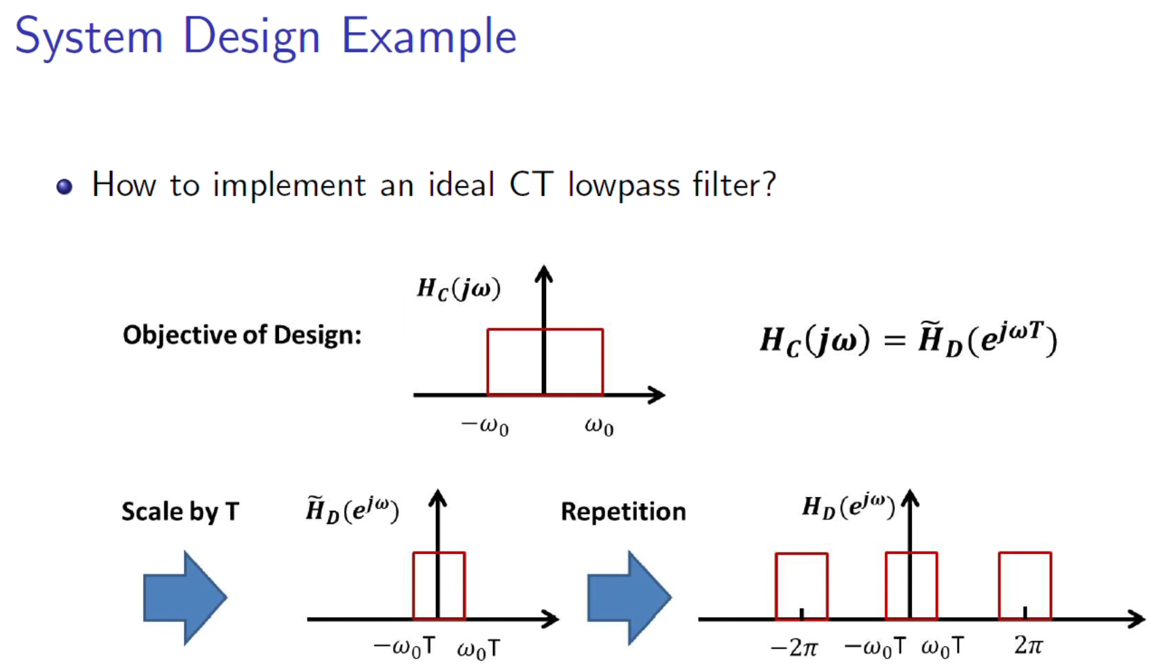

Slide 11
